Slide 1
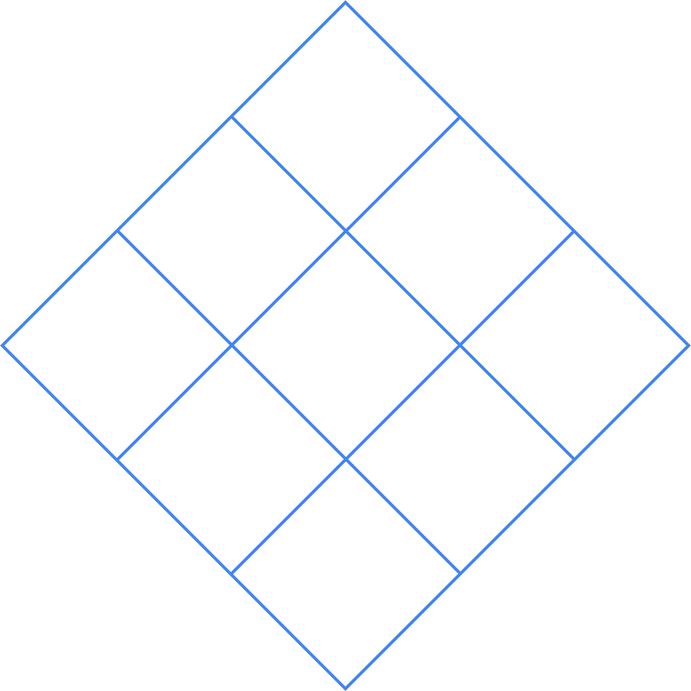

Idea generation diamond
Climate change
Space
Food science
Healthcare
Coding
Sustainable energy
Robotics/ electronics
Plant or animal conservation
Mental health & social science
Cut out each of the diamonds and read what is on them.
Put the thing you are least interested in at the bottom.
Complete the diamond, working your way up, putting the things you find most interesting towards the top.
What you’re most interested in should be at the top. What are your favorite things about the top three?
1. Identify a problem
Activity 1

